Slide 1

Gradient Boosting and XGBoost
21 Feb 2017
This document is confidential and is intended solely for the use and information of the client to whom it is addressed.
Notes:
Booz Allen Hamilton Standard Colors
Colors should be used in the color pairs whenever possible. Do not mix and match colors, use pairs together as shown.
Black, White and Gray can be used with any of the other colors.
Purple Pantone 2765
R 12
G 4
B 79
Green Pantone 357
R 15
G 67
B 24
Blue Pantone 2 88
R 11
G 31
B 101
Black
Pantone Cool Gray 6
R 158
G 158
B 158
Red Pantone 485
R 252
G 5
B 14
Yellow Pantone 3965
R 232
G 244
B 4
Aqua Pantone 319
R 126
G 204
B 189
White

Slide 2
Gradient Boosting: Crash Course
General overview: Gradient boosted decision trees are an effective off-the-shelf method for generating effective models for classification and regression tasks
Gradient boosting is a technique that can be applied to arbitrary 'underlying' weak learners - typically decision trees are used
Underlying intuition: we iteratively build a sequence of predictors, and our final predictor is a weighted sum of these predictors
At each step, we focus on adding an incremental classifier that improves the performance of the entire ensemble
Thus, if we have examples that are not well predicted by the current ensemble, the next stage will work harder to fit these examples
Algorithms in Python and R:
Python: scikit learn: GradientBoostingRegressor/Classifier
Python and R: XGBoost
R: gbm

Slide 3
Decision Trees
Decision trees: predictive model which maps observations about an item’s features to conclusions about that item’s target value
Underlying concepts:
(Shannon) Entropy: entropy is a measurement of the randomness of a data set. link
Decision tree summary:
Calculate entropy of every attribute using the data set
Split the data set into subsets using the attribute of which the resulting entropy (after splitting) is minimum (equivalently, information gain is maximum)
Make a decision tree node containing that attribute
Recurse on subsets using remaining attributes
Decision Tree algorithms:
ID3 → C4.5
CaRT

Slide 4
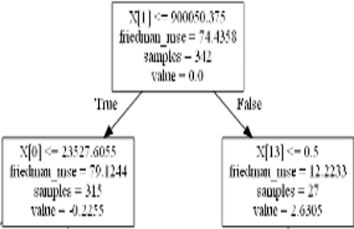
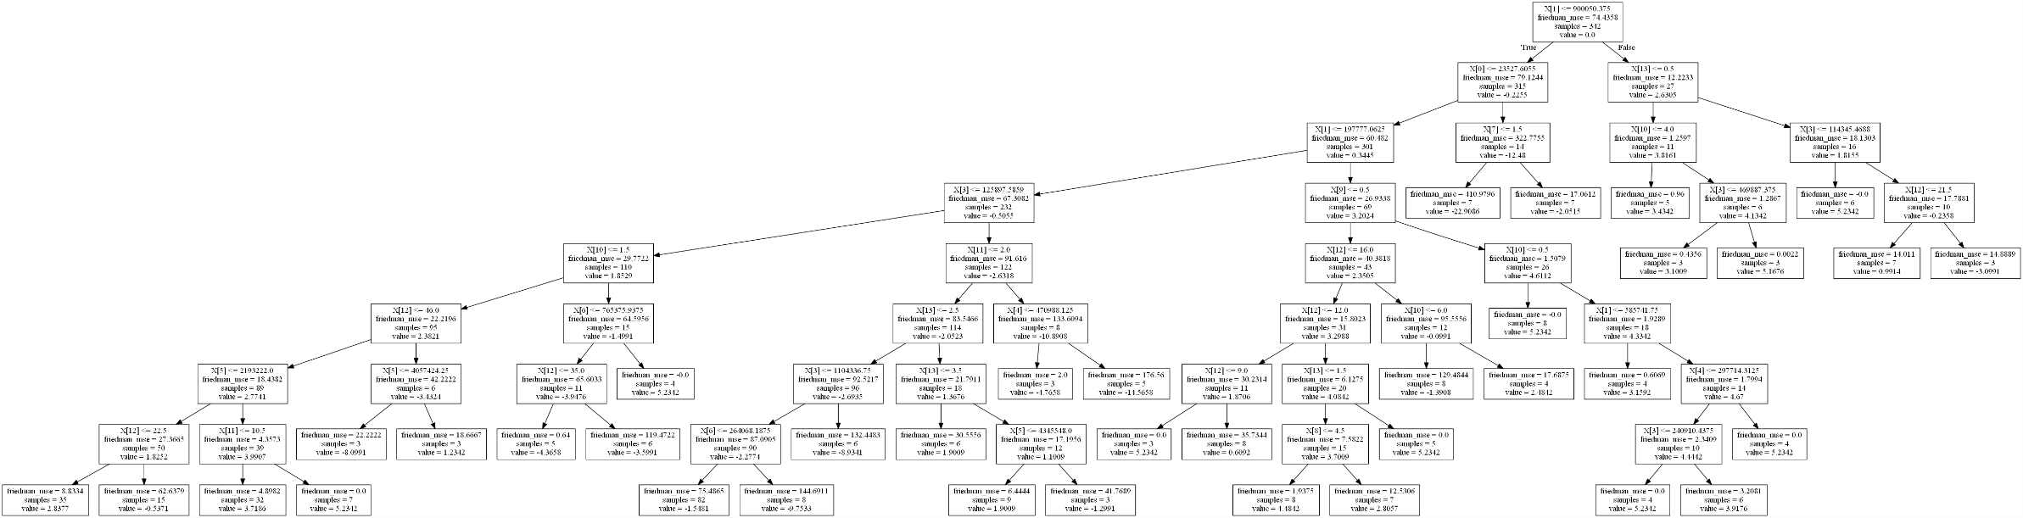
Decision Tree example

Slide 5
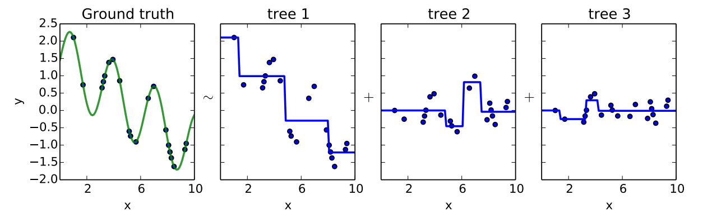
Gradient Boosting Cont’d
Use a fixed number of “decision trees”
Add more trees to minimize the error left from the previous tree

Slide 6
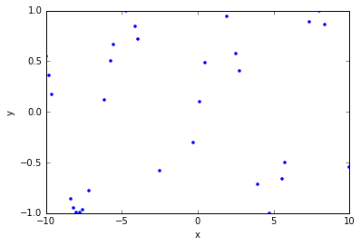
Notional data plot

Slide 7
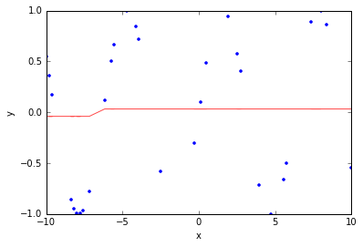
1 Decision Tree

Slide 8
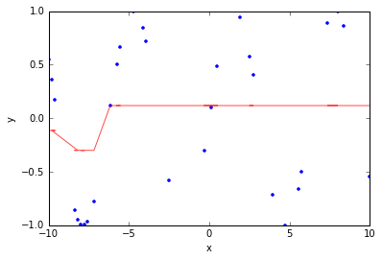
10 Decision Trees

Slide 9
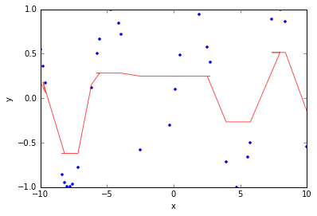
100 Decision Trees

Slide 10
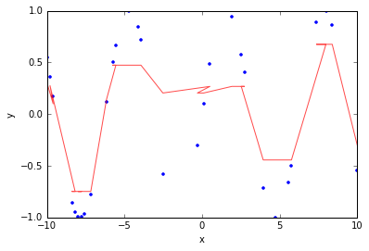
200 Decision Trees

Slide 11
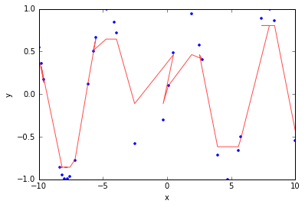
500 Decision Trees

Slide 12
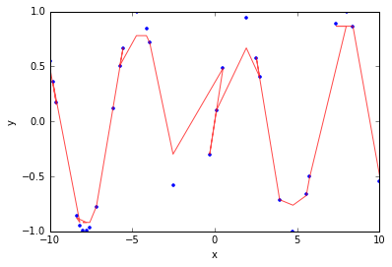
1000 Decision Trees

Slide 13
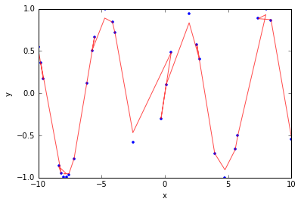
2000 Decision Trees

Slide 14
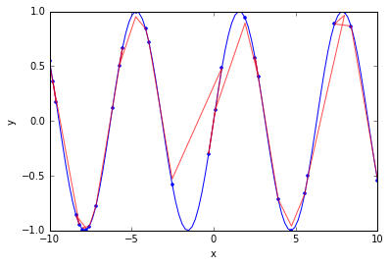
Modeling the Sine Wave

Slide 15
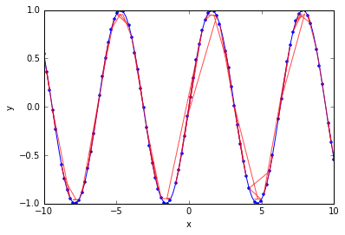
Increasing data improves model performance

Slide 16
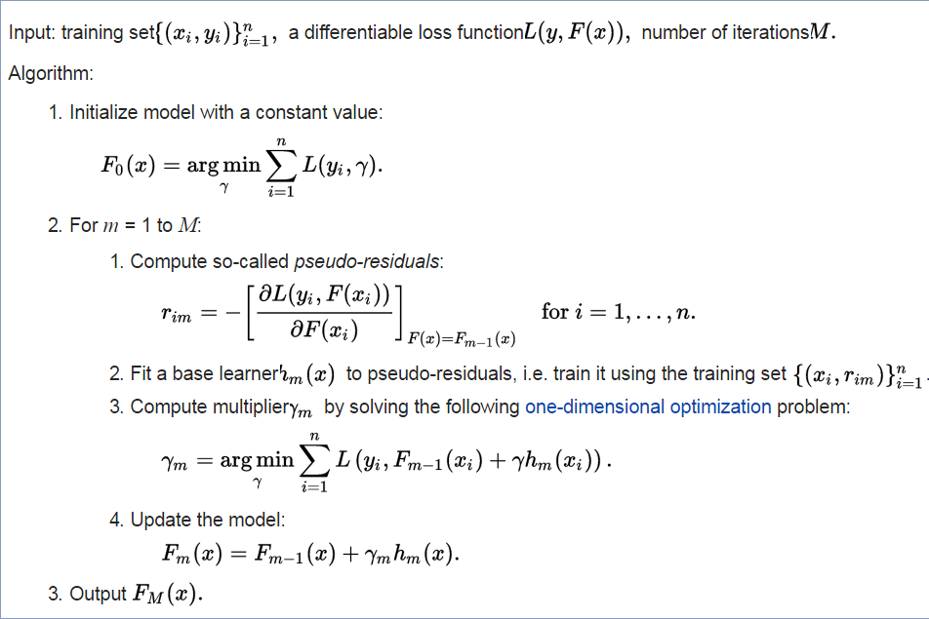
Gradient Boosting Pseudocode
Often times the mean is used

Slide 17
Advantages v. Disadvantages: Gradient Boosting
Advantages
Accommodates heterogeneous data: able to evaluate variables measured on different scales without transforming or converting to percentages
Automatically detects (non-linear) variable interactions
Disadvantages
Requires careful tuning: must tune many parameters to achieve optimal predictions
Slow to train (but fast to predict): if we have sufficient data, which is not the case for us, we could use a higher number of decision trees which take considerable time to create

Slide 18
XGBoost: eXtreme Gradient Boosting
XGBoost improves Gradient Boosting by increasing speed and adding regularization
Speed: accuracy improved using multiple cores and can run on Hadoop and Spark
Regularization within XGBoost: adding an additional term to the development of a decision tree that penalizes complexity
XGBoost employs an sub-algorithm that chooses decision trees to add to the gradient boosting model that reduces model error but are not overly complex (complex trees lead to overfitting)
In short, XGBoost does it faster and better
Link: explanation by the creator with a lot of underlying intuition scientific explanation

Slide 19


Bibliography
Friedman, J. H. "Greedy Function Approximation: A Gradient Boosting Machine." (February 1999)
Friedman, J. H. "Stochastic Gradient Boosting." (March 1999)
Friedman, J. H. "Greedy Function Approximation: A Gradient Boosting Machine." (April 2001)
Hastie, Trevor, Robert Tibshirani, and J. H. Friedman. The Elements of Statistical Learning: Data Mining, Inference, and Prediction: With 200 Full-color Illustrations. 2nd ed. New York: Springer, 2009.
https://github.com/dmlc/xgboost

